Slide 1


Beyond Observer Physics to Space Physics:
Beyond Religion and Science to Philosophy
Henry Lindner
henrylindner.net
Dedicated to:
Valerie Lindner
henrylindner.net/Valerie
B.S. Physics, Astronomy/Astrophysics, Mathematics
Physics PhD candidate
Physical and Mathematical Ontology Conference
Munich, Germany 2025

Slide 2
A TRAGIC MISUNDERSTANDING
Physicists and astrophysicists believe that Relativity and Quantum Mechanics are physical theories that tell them how the Cosmos works.
IN FACT: They are only mathematical models of the observer’s experiences and measurements. They model consciousness, not Cosmos.
Result: Misinterpretations, Contradictions, Confusion, and Nonsense
This problem is philosophical; it cannot be resolved by more evidence, experiments, or mathematical models.
The solution is also philosophical.

Slide 3
Philosophy = Love of Knowledge
The disciplined use of our neurological-intuitive and linguistic capabilities to understand the Cosmos and ourselves.
Method: Create and criticize theories to explain the nature and causes of everything.
Mastery of Language: Identify false or inadequate definitions, propositions, arguments, and theories and replace them with better ones (closer fit to reality).
Integration of all knowledge and all sciences within a comprehensive Cosmology
Logic, mathematics, and the scientific method are tools of philosophy: To assure that our linguistic formulas correspond to Cosmic reality.

Slide 4
Our Heritage: Natural-Cosmic Philosophy
Aristotle: It is the cause that we seek in all our inquiries…One who can give no account which includes the cause has no scientific knowledge.
Copernicus: The appearance of daily revolution belongs to the heavens, but the reality belongs to the Earth.
Galileo Galilei: These [Ptolemy’s devices] are not retained by philosophical astronomers who…seek to investigate the true constitution of the universe.
Isaac Newton: In philosophical disquisitions we ought to abstract from our senses and consider things themselves, distinct from what are only sensible measures of them.
Charles Darwin: It has recently been objected that this [theory of evolution] is an unsafe method of arguing; but it is a method used…by the greatest natural philosophers…the belief in the revolution of the earth…was until lately supported by hardly any direct evidence.

Slide 5
Sciences Work within Paradigms
Paradigm: Set of assumptions and theories about a subject and how to study it
Normal Science = Research and reasoning within a paradigm
If false or inadequate: Anomalies accumulate; scientists recategorize or ignore them
Defective paradigms persist until replaced—by an act of philosophical cognition.
Examples: Copernicus and Darwin replaced observer-based and God-magic paradigms with Cosmic models and theories.
Thomas Kuhn, The Structure of Scientific Revolutions (1962)

Slide 6

My Journey:
From Christianity to Cosmism
Two metaphysical-epistemological paradigms:
Primacy of Consciousness (POC)
Primacy of Existence (POE)
  POC = Subjectivism: We describe and model the contents of our consciousness—our sensations and measurements. (a.k.a. spiritualism, idealism)
  POE = Objectivism::We describe, model, and explain the Cosmos that produced us and our consciousness and that causes our experiences. (a.k.a. Cosmism)

Slide 7
Objectivism→Evolutionary Cosmology
Cosmos exists and evolves, producing hierarchical levels of complexity:
  Astrophysicochemical – light, subatomic particles (3), gravity, atoms (90), chemicals (10⁸) (stars, planets, galaxies)
  Biological – molecules, prokaryotes, eukaryotes, multicellular, histologic (RNA-DNA, bacteria, plants, animals)
  Neuropsychological –sensation, neurons, information processing, brains, emotions, consciousness (higher animals)
  Linguo-Mythic (language) → toolmaking, culture, religion, civilization, technology (Homo sapiens)
  Linguo-Philosophical – disciplined linguistic information processing (7th cent. BC Ionia—Our Potential)

Slide 8
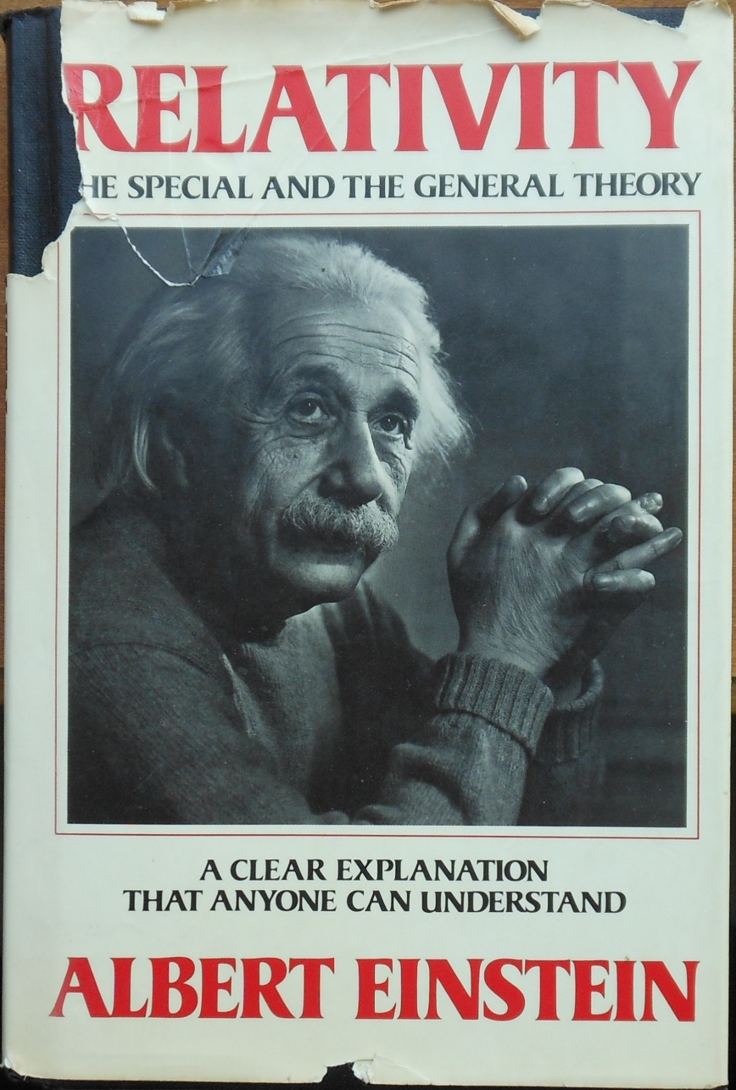
What is Cosmos made of?
Mass-Energy and Space-Time
JUST MEASUREMENTS!
Made by observers, with their rods, clocks, scales, photomultipliers, etc.!
Relativity = Primacy of Consciousness = Subjectivism

Slide 9
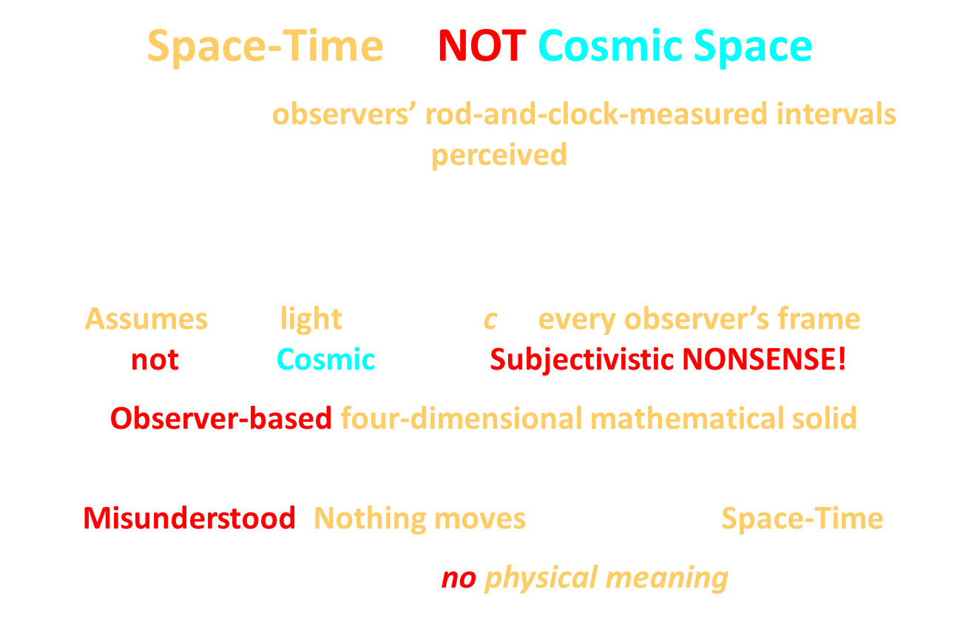
Space-Time is NOT Cosmic Space!
Composed of observers’ rod-and-clock-measured intervals between perceived events:
$${ds}^{2}=c^{2}{dt}^{2}−({dx}^{2}+{dy}^{2}+{dz}^{2})$$
Assumes that light travels at c in every observer’s frame—
not in any Cosmic frame –Subjectivistic NONSENSE!
Observer-based four-dimensional mathematical solid:
“Block Universe”, “frozen river” of past, present and future.
Misunderstood: Nothing moves in or through Space-Time!
The chronotropic interval has no physical meaning or significance.
Einstein, quoted by T. Levi-Civita, Nuovo Cimento, 13, 45 (1936)
Distance
Distance

Slide 10
Einstein’s Subjectivistic Paradigm
Science is methodical thinking directed toward finding regulative connections between our sensual experiences. Ideas and Opinions, p. 50 (1954)
The only justification for our concepts and system of concepts is that they serve to represent the complex of experiences; beyond this they have no legitimacy. The Meaning of Relativity, p 3 (1922)
With Relativity…The struggle between the views of Ptolemy and Copernicus would then be quite meaningless. Either coordinate system could be used with equal justification. Evolution of Physics, p. 224 (1938)
Einstein tried to nullify the Copernican Revolution!
WHY?

Slide 11
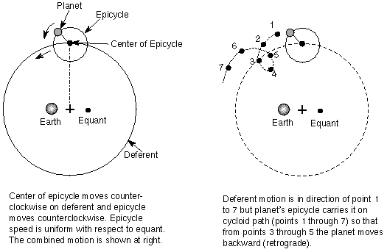
Been There: Observer-Based Science
Ptolemaic
Cosmology
Ptolemy’s ad hoc devices modeled the Earth observer’s experiences and measurements but had no Cosmic-physical reality = DEAD END: No further discovery/understanding
The observer-based concepts of Relativity and QM are epistemologically equivalent:
Absolute c for every observer, space-time interval, time dilation, photon, virtual particles, particle exchange, wave-function collapse, Higgs field, etc.

Slide 12
Why are We Stuck with Observer-Based Physics?
By 1900: Many difficult questions about ether-space, gravity, light, and particles:
Einstein tried to create a simple physics without physical Space—
without the Newton-Maxwell-Lorentz inertial-electromagnetic ether
HOW?
By instead relating phenomena to observers or arbitrary frames, and restricting physics to the mathematical modeling of observers’ sensations and measurements.
WHY?
CLUE: Einstein credited David Hume and Ernst Mach for his approach to physics.
They were influenced by Bishop Berkeley.

Slide 13
Historic Background:
Christian Spiritualism vs. Philosophy
3rd to 13th cent: Western Christendom educated by Aristotle’s works on logic → Western civilization’s unique philosophical competence
5th cent: Byzantine Emperor Justinian closed Aristotle’s and Plato’s schools in Athens
13th cent: Aristotle’s other works surfaced. Western Church condemned his Cosmic theses
14th cent: Friar William of Ockham attempted to free theology from natural philosophy:
We should not posit any God-independent causes or mechanisms. We should only describe our experiences using the fewest propositions necessary. (paraphrase)
Ockham’s Razor: The simplest explanation is always “GOD” (MAGIC)!

Slide 14
Christian Dualism: Spirit World vs. Cosmos
René Descartes: I think therefore I am (POC). The Cosmos could be a hallucination produced by a demon. Meditations on First Philosophy Med. I, para. 10 (1641)
Theorizing about final [Cosmic] causes is a sin. Ibid: Med. IV, para. 5, 9
Universal Mathematics: We should pursue only certain, indubitable knowledge—the mathematical description of our sensations. For this he invented his three-axis coordinate system.
John Locke: Also more certain of spiritual than physical [Cosmic] existence (POC).
An Essay Concerning Human Understanding, Bk. II, chap. XXIII, para. 15 (1690)
Empiricism: We can only know the ideas presented to us by our senses and can never pass beyond them to any knowledge of the nature and hidden causes of those ideas. Ibid: para. 29
PROBLEM: Two realities—Spirit World and Cosmos—How do they coexist and interact?

Slide 15
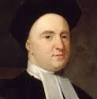
Berkeley Rejects Dualism: Creates Science to Save Christianity from Philosophy
Realized: Copernicus’ and Newton’s Cosmic theories threatened spiritualism/religion
Attacked: Newton’s space and matter as atheistic: Existing without mind and God
Solution: Spiritual Monism (No Cosmos): We are spirits and can only know our spiritual experiences. Principles of Human Knowledge body, para. 18 (1710)
We exist in a spiritual simulation created and run by God (as in the movie The Matrix, 1999)
Subjective Idealism: The Sun is a God-given apparition. Everything is God-Magic.
⸫ We should only describe and mathematically model our experiences and measurements
Science should only seek the rules of God’s Matrix (“Laws of Nature”).
Popper, Karl. A Note on Berkeley as a Precursor of Mach and Einstein, Conjectures and Refutations (1962)

Slide 16
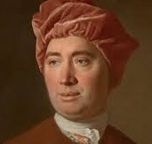
David Hume: Agnostic Subjectivism
Skepticism: We cannot be certain of the existence of Berkeley’s God-Matrix or a physical Cosmos.
Subjectivism: We can only know our ideas and the connections among them. (POC)
Our belief that an effect will follow from a cause is merely a custom we have acquired by experience.
An Enquiry Concerning Human Understanding, sec. V, part. II, para. 11 (1748)
We will never know the cause of such a “custom” as gravity. Ibid: sect. IV, part 1, para. 13
NONSENSE: Rejected Berkeley’s spiritual metaphysics but kept his
spiritualistic/subjectivistic epistemology!

Slide 17
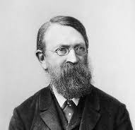
Ernst Mach: Modern Subjectivistic Science
Admitted influence of Berkeley and Hume—and denied both God and Cosmos!
Subjectivism (POC): The world consists only of our sensations; Laws state relations between sensations. Analysis of Sensations, p. 12 (1897)
Redefined theories as mathematical models of our sensations and measurements (persists today)
Anti-theory: Refused to believe in atoms because they were not evident to our senses.
Replaced natural philosophy with positivistic Science (capital “S”, Hard Science, Shut up and calculate)
Mach’s Science = Modern Science = Anti-philosophy
Observer-based, merely descriptive, anti-theoretical—STUPID

Slide 18
Einstein’s Evolution:
Beyond Hume and Mach to Berkeley
Beyond Mach: …in my younger years…Mach’s epistemological position also influenced me very greatly…[but] today appears to me to be essentially untenable. For he did not place in correct light the essentially constructive and speculative nature of thought and more especially of scientific thought. Schlipp
To Berkeley: Physics is an attempt conceptually to grasp reality as it is thought, independently of its being observed. In this sense, one speaks of “physical reality”. Schlipp (ed). Albert Einstein, Philosopher-Scientist (1949)
Berkeley’s Matrix: Einstein believed in an “external world independent of the perceiving subject”, but defined it inter-subjectivistically, as the sum total of all events about which subjects agree.
Result: Einstein’s concepts—atoms, lightquantum (photon), absolute c, frames, space-time, etc. exist only as thought—freely created ideas that help to organize our experiences.
Einstein’s physics = Modern physics = Rules of Berkeley’s Matrix
Rejected QM as incomplete because it failed to find deterministic rules of the Matrix

Slide 19
Origins of Relativity
Protagoras: Man is the criterion of all objects…“He posits only what appears to each individual, and thus he introduces relativity.” Sextus Empiricus, Outlines of Pyrrhonism, I. 216 sq. (3rd cent. AD)
Bishop Berkeley: We must treat motion not as absolute, Cosmic, or real but as merely relative to ourselves or to other objects in our consciousness, and treat time as the succession of events in our consciousness. (paraphrase) Principles of Human Knowledge para. 112., para. 98 (1710)
Ernst Mach: Newton’s absolute space and motion “devoid of content”; we only know “relative spaces and motions”. Those who share this view are “relativists”. The Science of Mechanics, 283, 293 (1883)
POC = Spiritualism = Denial of a physical Cosmos!

Slide 20
PROOF: No Cosmos in Special Relativity
The Restricted Principle of Relativity: All laws of Nature are the same in all coordinate systems (CSs) moving uniformly relative to each other.
The Law of Propagation of Light: The velocity of light in vacuo is a law of Nature for all CSs. (Absolute c for every observer)
Lorentz Covariance: Differences observed between moving CSs are described by the Lorentz transformations
There is…no such thing as an independently existing [Cosmic] trajectory, but only a trajectory relative to a particular body of reference (CS).
Light’s motion not related to any Cosmic frame(s), i.e., NOT to planets, stars, or galaxies!
No physical Space = No physical Cosmos = No physical causation
Rules of the Matrix = Bishop Berkeley’s Physics!
Relativity, The Special and General Theory, p. 10 (1920)

Slide 21
Relativity Never Worked—Twin Paradox
“Relativity” means that all motion is merely relative to any frame of reference.
Any two frames in relative motion have identical trajectories in each other’s CSs.
Each should see the other’s clock run slow and length contracted (contradiction).
To “resolve the paradox” one must break the symmetry with a third (independent-Cosmic) frame
This violates Relativity—so is done surreptitiously (e.g., “absolute” acceleration, “changing frames”, etc.)
FACT: There is always asymmetry and inequality among frames = NO RELATIVITY!
Physicists do not understand Relativity! They are confused.

Slide 22
No Cosmos in General Relativity
Acceleration/rotation remained “absolute”—needed to be “relativized”
General Principle of Relativity: “All laws of Nature are the same in all arbitrary frames, no matter what their state of motion”
NON-STARTER. IMPOSSIBLE. RIDICULOUS.
Acceleration/rotation are “absolute”, physical, Cosmic. One cannot relate “laws of Nature” to rotating/tumbling CSs! (Recall the Copernican Revolution!)
Confusion: GR morphed into a geometrical model of matter’s effect on “frames” in its surrounding space.
(A quasi-objective model; NOT A GENERALIZED RELATIVITY)
“Space-time curvature” is a geometrical description of gravity’s effects on the observer’s rod-and-clock- measured intervals: NOT a theory of gravity!
GR is observer-contaminated: Light moves at c in all free-falling observers’ frames!

Slide 23
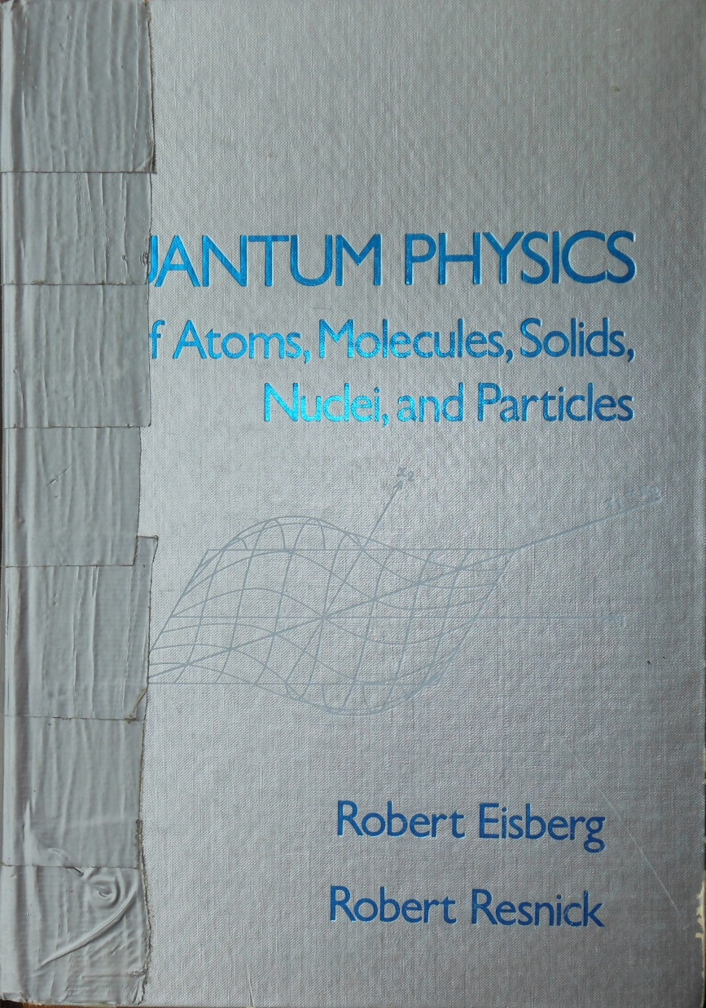
No Cosmos in Quantum Mechanics
Einstein created QM in 1905 with his lightquantum
Pure Machian Science
Quantum mechanics…rejects as meaningless and useless the notion that behind the universe of our perception there lies a hidden objective world ruled by causality; instead, it confines itself to the description of the relations among perceptions.
Ad hoc observer-based model, NOT a physical theory.
Models observers’ “information”, not Cosmos.
All quantum “spookiness” stems from its bizarre epistemology:
Subjectivism IN: Subjectivism OUT
Valerie: “Best QM textbook”

Slide 24
Einstein’s Metaphysics
Mathematical Idealist: Nature is the realization of the simplest conceivable mathematical ideas. Ideas and Opinions, 274 (1954)
Berkeleyan Theist: God is “a superior mind that reveals itself in the world of experience.” Ideas and Opinions, 262 (1954)
Forbade physical theory: According to the general theory of relativity space is endowed with physical qualities; …But this ether may not be thought of…as consisting of parts which may be tracked through time. The idea of motion may not be applied to it. Ether and the Theory of Relativity (1920)
Note to self: Let’s give Space parts and motion!

Slide 25
Einstein’s Legacy: Contradiction and Confusion
Admitted that in epistemology, he was an “unscrupulous opportunist”, resorting to realism, idealism, positivism, and Platonism as the situation seemed to require.
Realized that he failed to eliminate Ether-Space from physics, but clung to Relativity
Inconsistency is bad philosophy: Physicists are not philosophers—have been fooled
Academic “philosophers” unable/afraid to criticize Relativity, QM, and positivistic Science
Acceptance of subjectivism, contradiction, and unreality→Destruction of philosophy
Result: 120-year corruption of physics and philosophy
Albert Einstein: Philosopher-Scientist, p. 684

Slide 26
The Costs of Anti-Philosophical Science
Humans unable to identify contradictions, fallacies, flawed arguments
Unable to question and replace false ideas/theories: Stuck with false paradigms!
Unable to understand causes that are not immediately obvious.
Unable to replace religion with philosophical Cosmism (just as Bishop Berkeley intended)
FALSE PARDIGMS: In anthropology, psychology, economics, politics, medicine, etc., etc…
CHILD ABUSE: Churching and Schooling destroy curiosity and philosophical development
Western civilization is rapidly deteriorating because SCIENCE is STUPIDITY

Slide 27
SOLUTION: A Proper Metaphysics
Instead of Berkeleyan/Humean/Machian spiritualism/idealism:
Cosmism
Cosmos exists and evolves. It produced us humans and our language-enhanced consciousness. Through us Cosmos has become linguistically self-conscious.
Cosmism is the best theory to explain our existence and experiences.
Foundational Assumption: Cannot be proven, cannot be falsified.
New language for philosophical Cosmology: We should capitalize proper nouns: “Cosmos”, “Sun”, “Earth” “Moon”, etc.
We should also drop “the” before the names of the most important objects in our existence!

Slide 28
A Proper Epistemology
Instead of Berkeleyan/Humean/Machian subjectivism:
objectivism
We must relate our experiences and measurements to Cosmic entities and frames to produce a model of the Cosmos.
Only objectivistic-Cosmic models can inform causal-Cosmic theories!
(e.g., Copernican vs. the Ptolemaic System)

Slide 29
What Is Actually Proven? Not Relativity!
Lorentz transformations—when applied to the correct Cosmic frame(s)
Light is a wave in electromagnetic (EM) Space, has quantized interactions with electrons.
Matter cannot move at c through EM Space.
Matter alters its surrounding inertial-EM Space creating gravity and its own inertia.
Velocity in Space and gravity redshift atomic/nuclear spectra; i.e., slow atomic clocks.
We should capitalize Cosmic-physical “Space” to differentiate it from mathematical and imaginary spaces.

Slide 30
Easy: Replace Relativity and QM with Space Theory
2025: We can restore the suppressed inertial-EM Space to physics—create a working theory of Space and its role in electromagnetism, particle formation, gravity, and inertia.
Replace Special Relativity with Lorentz Ether Theory^{1,2}
Replace General Relativity with Flowing Space³
Replace Quantum Electrodynamics with an EM wave theory of light and electrons and their interactions.⁴
¹Builder, G. Ether and Relativity. Aust. J. Phys. 11, 279-297 (1958) 10.1071/PH5802790
²Mansouri, R., Sexl, R.U. A Test Theory of Special Relativity: I. Simultaneity and Clock Synchronization. Gen. Rel. Gravit. 8, 497-513 (1977) 10.1007/BF00762634
³Lindner H.H. Beyond Newton and Einstein to flowing space, Phys. Essays 25(4), 500-509 (2012) 10.4006/0836-1398-25.4.500
⁴Lindner H.H. A QED-compatible Wave Theory of Light, Electrons, and their Interactions”, Proc. SPIE, vol. 8121, 2011, p. 81210X-1. 10.1117/12.893053

Slide 31
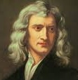
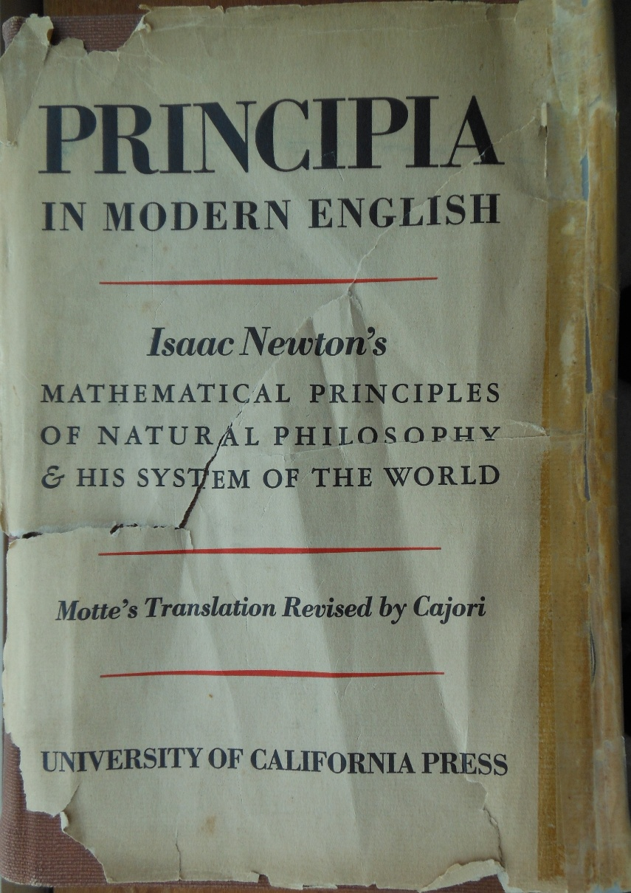
Starting Point: Newton’s Inertial Space
Misunderstood Cosmic model
Inertial medium: A single, Euclidean Cosmic Space that resists the forced acceleration of matter, but offers no resistance to matter’s uniform velocity
An Ether theory: All matter has a definite velocity in Space even if we can’t determine it.
Implication: Matter cannot naturally accelerate wrt Space. IF Space accelerates in some direction, matter must accelerate with it; would not “feel” acceleration.

Slide 32
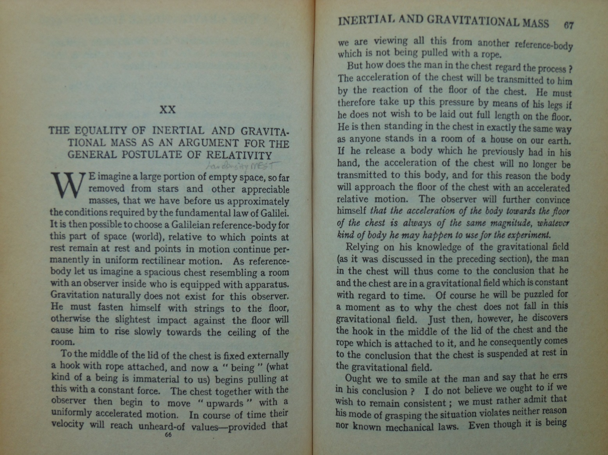
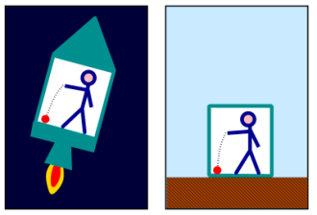
Credit Due: Einstein Found the Key to Gravity
“Man in Chest” gedanken
Principle of Equivalence (POE) of inertial and gravitational acceleration (not “mass”)

Slide 33
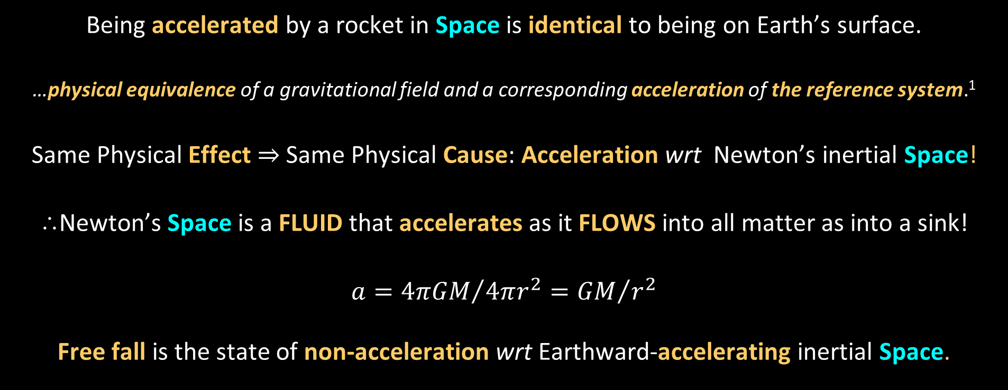
Newton’s Space + Einstein’s POE → Flowing Space
Being accelerated by a rocket in Space is identical to being on Earth’s surface.
…physical equivalence of a gravitational field and a corresponding acceleration of the reference system.¹
Same Physical Effect $⇒$Same Physical Cause: Acceleration wrt Newton’s inertial Space!
⸫Newton’s Space is a FLUID that accelerates as it FLOWS into all matter as into a sink!
$$a={4πGM}/{4πr^{2}={GM}/{r^{2}}}$$
Free fall is the state of non-acceleration wrt Earthward-accelerating inertial Space.
¹Einstein, A. On the Relativity Principle and the Conclusions Drawn From It. Jahrb. Radio. Elektron. 4:411–462 (1907)

Slide 34
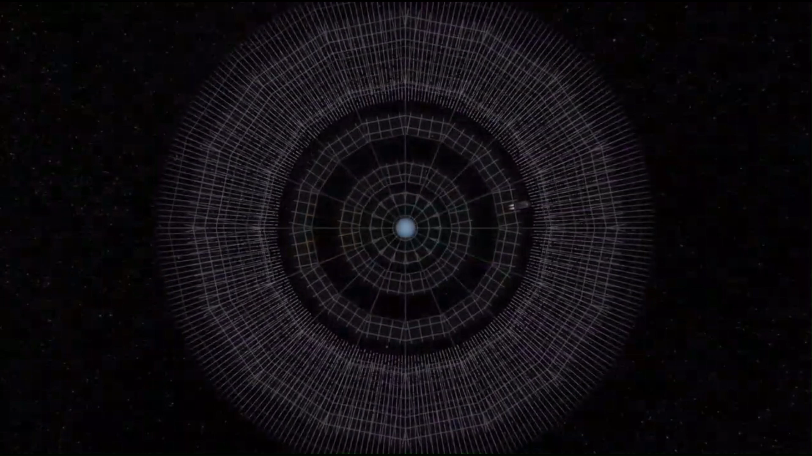
Dialect: Flowing Space
The River Model of General Relativity (youtube.com)

Slide 35
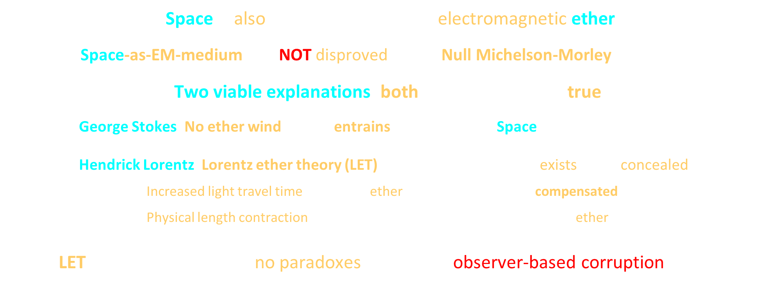
Inertial Space is also the Electromagnetic Medium
Space is also the Maxwell-Lorentz electromagnetic ether
Space-as-EM-medium was NOT disproved by the Null Michelson-Morley experiment
Two viable explanations; both now appear to be true:
  1. George Stokes: No ether wind:¹ Earth entrains its surrounding Space into its orbital free-fall motion
  2. Hendrick Lorentz: Lorentz ether theory (LET):² ±$30km/s$ether wind exists but is concealed by:
  Increased light travel time across the ether flow (“time dilation”) compensated by
  Physical length contraction of device in direction of motion through the ether
LET works and produces no paradoxes.^{3,4} SR is an observer-based corruption of LET.
¹Stokes, G. On the Aberration of Light. Philos. Mag. 27, 9-15 (1845)
²Lorentz, H.A. Attempt of a Theory of Electrical and Optical Phenomena in Moving Bodies, E. J. Brill, Leiden (1895)
³Builder, G. Ether and Relativity. Aust. J. Phys. 11, 279-297 (1958) 10.1071/PH5802790
⁴Mansouri, R., Sexl, R.U. A Test Theory of Special Relativity: I. Simultaneity and Clock Synchronization. Gen. Rel. Gravit. 8, 497-513 (1977) 10.1007/BF00762634

Slide 36
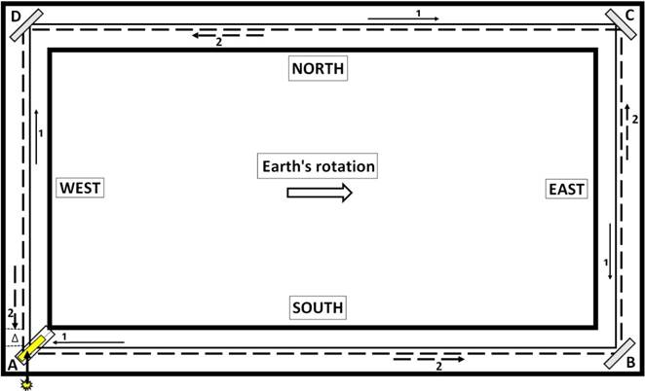
Rotation Proves that Space is the Inertial/EM Medium
Michelson-Gale Experiment:¹ 2000’x1000’ rectangular interferometer in Illinois
Fringe shift $⇒$Light propagates in a medium that is not rotating with Earth (Sun-star irrotational).
Sagnac effect, laser gyroscopes
Rotation wrt Space is inertially and electromagnetically “absolute”, physical, real, Cosmic
NO GENERAL RELATIVITY; NO RELATIVITY ANYWHERE!
¹Michelson, A., Gale, H. The Effect of the Earth’s Rotation on the Velocity of Light, Part II. Astrophy. J. 61, 140 (1925) 10.1086/142879

Slide 37
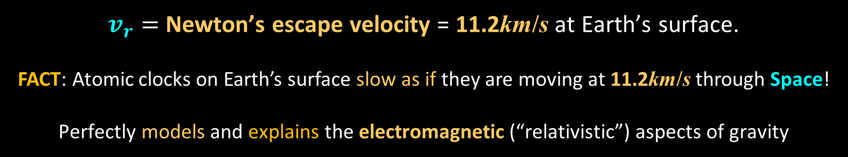
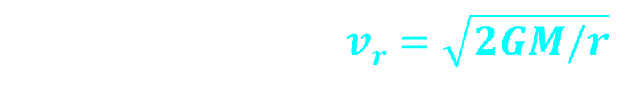
What is the Gravitational Flow’s Velocity?
Work needed to move a test mass, $m_{0}$, away from mass, $M$, to infinite distance:
$${W=\int_{r_{0}}^{∞}{G{Mm_{0}}/{r^{2}}}dr= U_{e} → K}_{e}−U_{e}=\frac{1}{2}m_{0}v^{2}−{GMm_{0}}/r=0$$
$$v_{r}^{2}= {2GM}/r → vr=\sqrt{2GM/r}$$
$v_{r}=$Newton’s escape velocity = 11.2km/s at Earth’s surface.
FACT: Atomic clocks on Earth’s surface slow as if they are moving at 11.2km/s through Space!
Perfectly models and explains the electromagnetic (“relativistic”) aspects of gravity
¹Lindner H.H. Beyond Newton and Einstein to flowing space, Phys. Essays 25(4), 500-509 (2012) 10.4006/0836-1398-25.4.500

Slide 38

Velocity in Space Redshifts Atomic Spectra!
Lorentz velocity redshift: $Δυ/υ=1−\sqrt{1−v^{2}/c^{2}}$
In Flowing Space gravity: $v_{esc}^{2}=2GM/r$, therefore
Gravitational redshift: $Δυ/υ=1−\sqrt{(1−2GM/rc^{2})}$
Atomic redshift/clock slowing has one physical cause: Velocity in EM Space
$⇒$Expanded Principle of Equivalence of Inertial and Gravitational
Acceleration and Velocity!
Simplification and Unification: Integrates microcosm and macrocosm (“QM and GR”)!

Slide 39
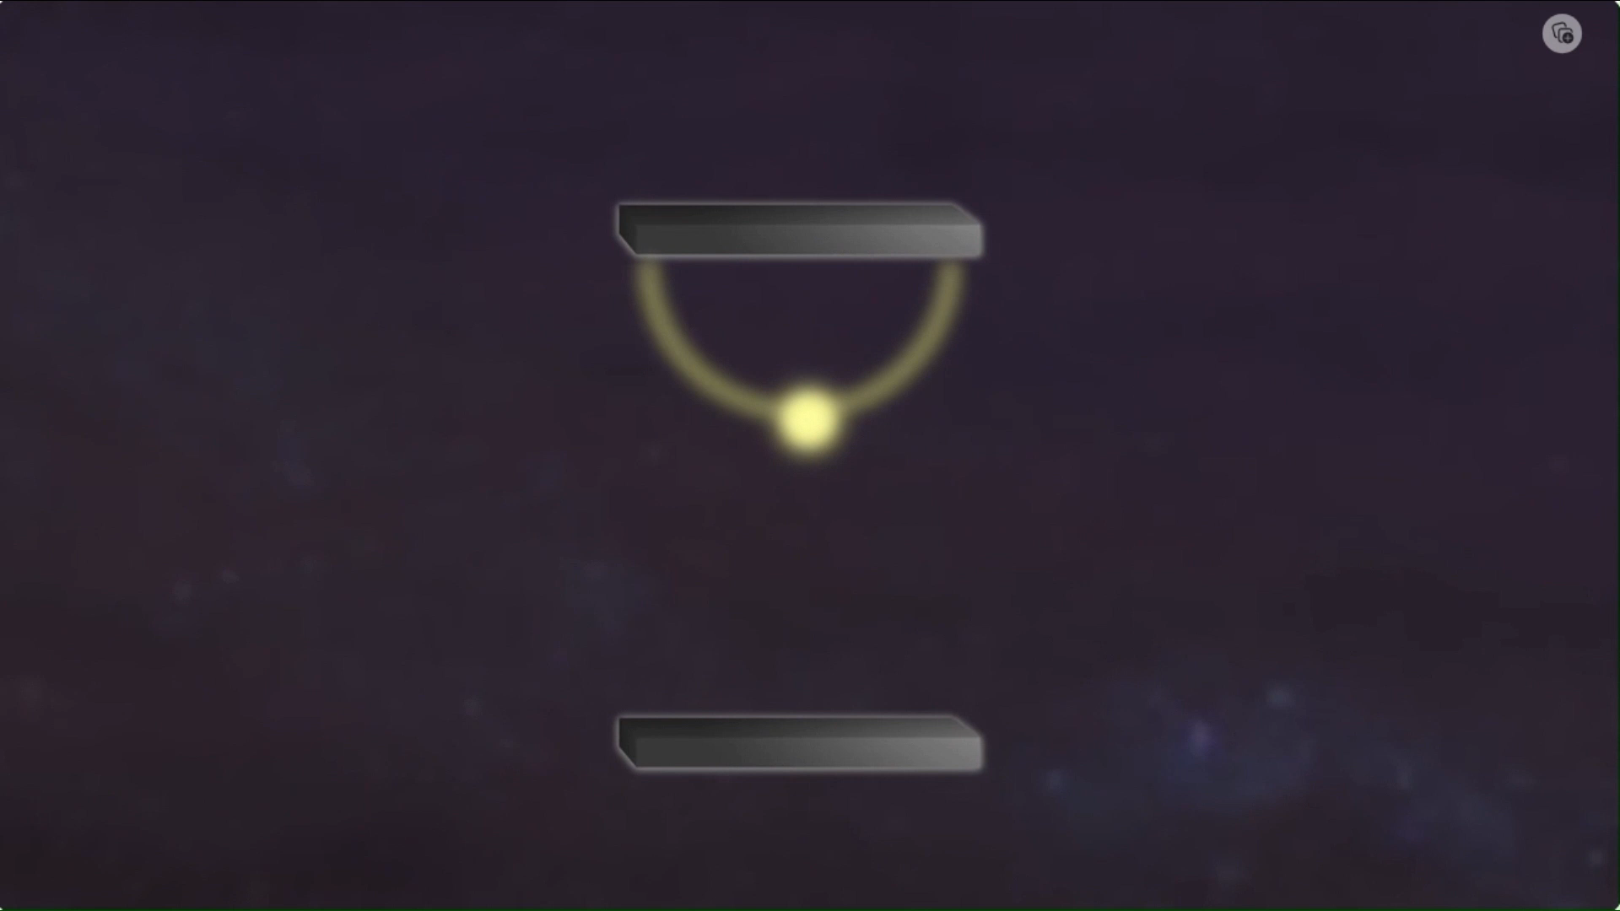
Dialect: Light Clock
What Time Dilation ACTUALLY IS in Relativity (youtube.com)

Slide 40
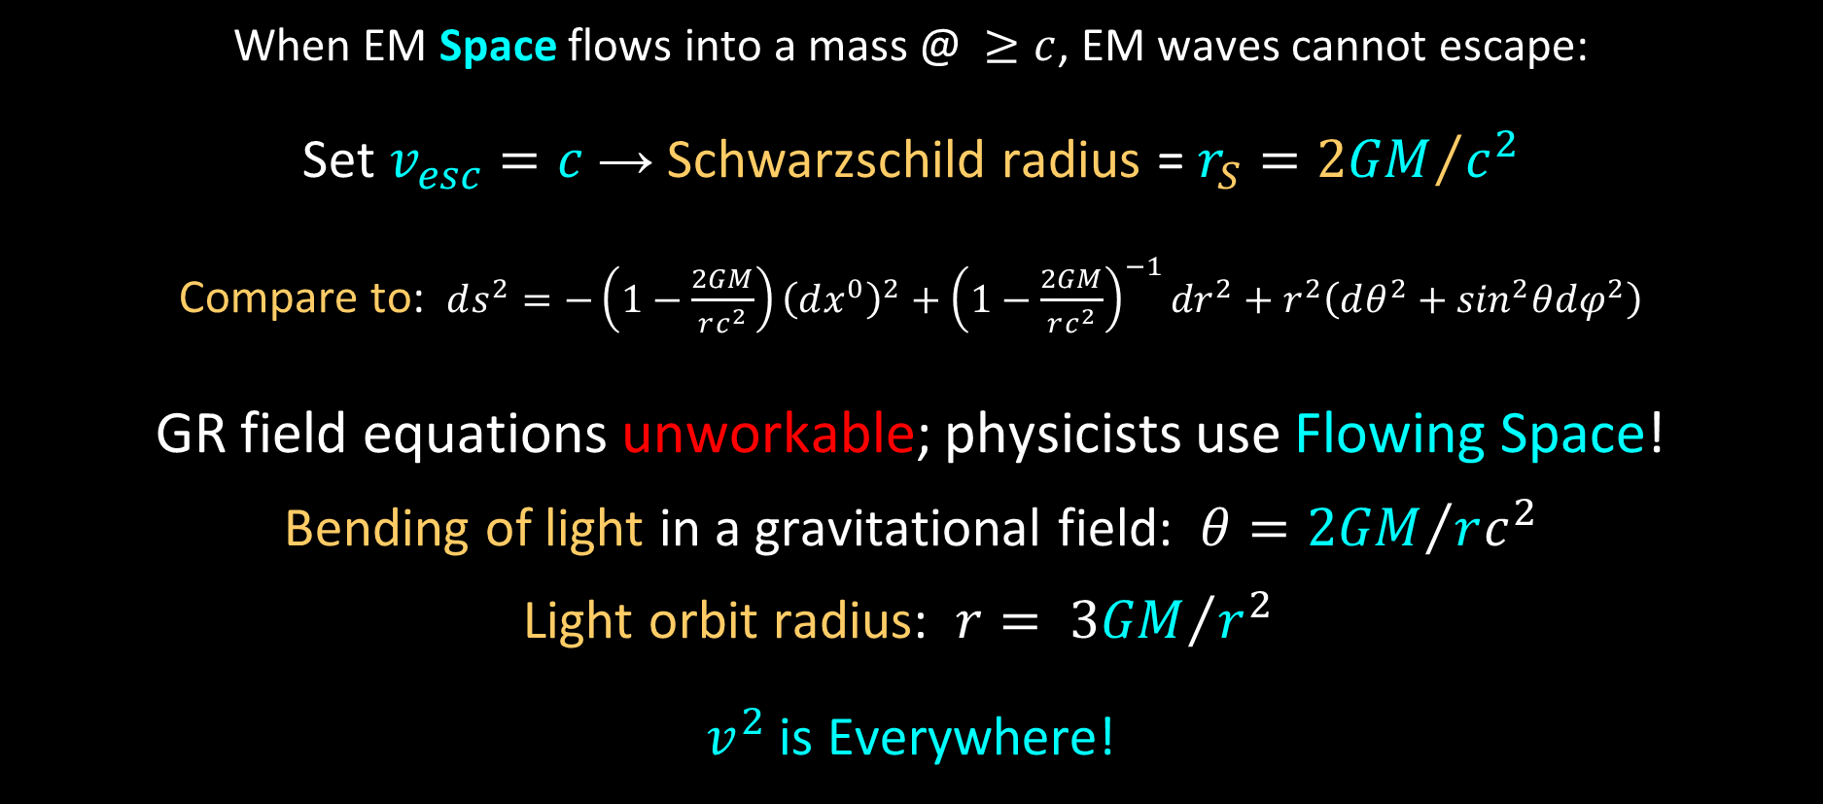
Flowing Space Explains Black Holes
When EM Space flows into a mass @ $≥c$, EM waves cannot escape:
Set $v_{esc}=c$ → Schwarzschild radius = $r_{S}={2GM}/{c^{2}}$
Compare to: $ds^{2}=−\left(1−\frac{2GM}{rc^{2}}\right){\left(dx^{0}\right)}^{2}+{\left(1−\frac{2GM}{rc^{2}}\right)}^{−1}{dr}^{2}+r^{2}\left(dθ^{2}+\sin^{2}θdφ^{2}\right)$
GR field equations unworkable; physicists use Flowing Space!
Bending of light in a gravitational field: $θ={2GM}/{rc^{2}}$
Light orbit radius: $r= {3GM}/{r^{2}}$
$v^{2}$ is Everywhere!
Preti, G. Schwarzschild Radius Before General Relativity: Why Does Michell-Laplace Argument Provide the Correct Answer? Found. Phys. 39, 1046-1054 (2009) 10.1007/s10701-009-9315-8

Slide 41
We have Always been Detecting Spatial Motion!
Spatial Acceleration
The acceleration of any test mass in free-fall reveals the acceleration of Space at that location. Accelerometers measure acceleration wrt Cosmic Space.
Spatial Speed
The redshift of atomic spectra (slowing of atomic clocks) reveals their speed wrt Space.
NO RELATIVITY ANWHERE!

Slide 42
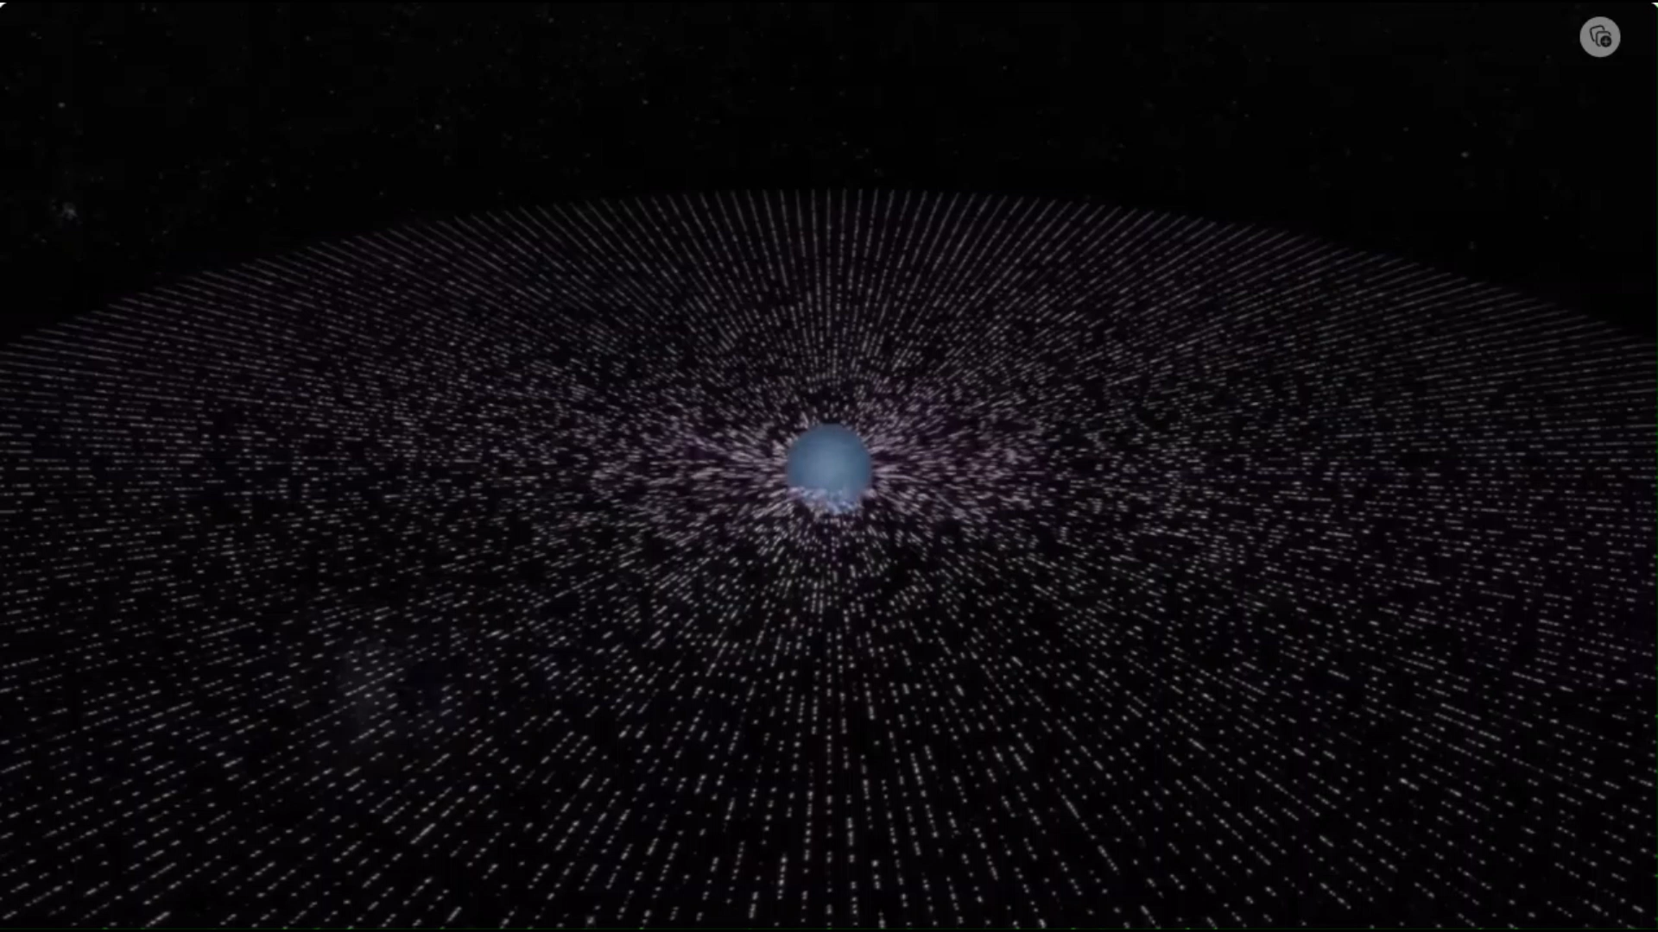
Dialect: Matter and Light moving in Flowing Space
The River Model of General Relativity (youtube.com)

Slide 43
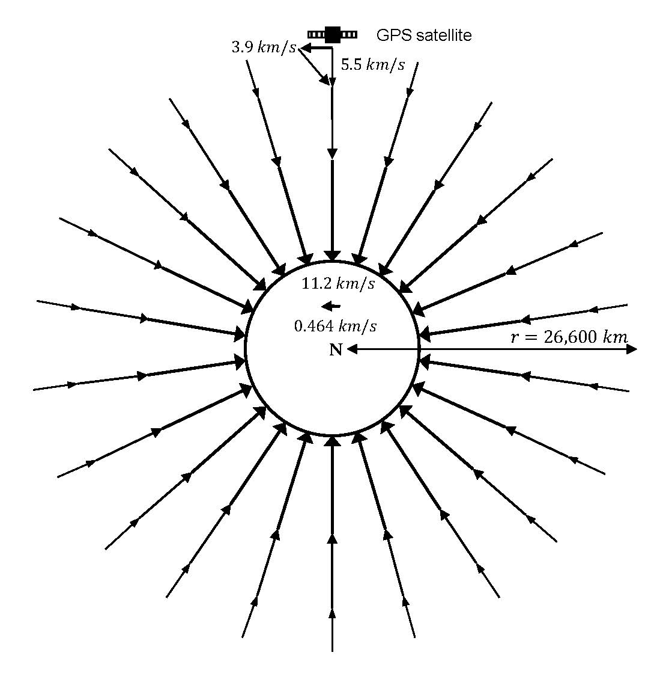



Global Positioning System (GPS) works by Flowing Space.
No Relativity Here!
GPS atomic clocks slowed by their speed in Earth’s entrained inflowing Space
Su, C-C. A local-ether [entrainment] model of propagation of electromagnetic wave, Eur. Phys. J. C, 2001, v.21, 701
$6.7$ km/s
$30 km/s$Orbital Motion
$30 km/s$Orbital Motion
Earth and its entrained (co-moving) sink-flow field moving through Sun’s entrained flow field
The atomic clock of a GPS satellite is subjected to a $5.5 km/s$ Spatial inflow and so runs faster than the Earth surface clock ($11.2 km/s$). Satellite’s clock also slowed by its $3.9 km/s$tangential orbital velocity in the Earth-entrained flow-field.
Resultant Spatial speed is $6.7km/s⇒$ correct GPS atomic clock slowing.

Slide 44
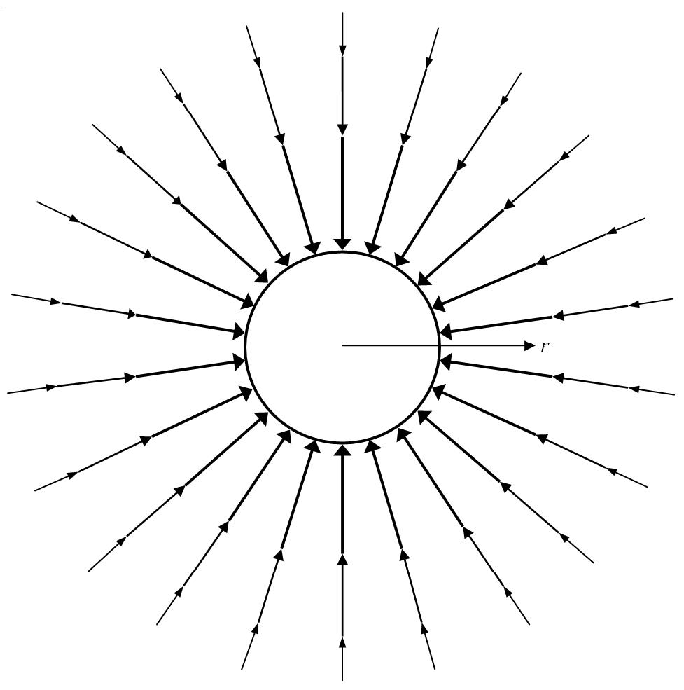
Additional predictions not found in GR
Anisotropic light propagation: Light will rise/fall in gravitational field at c ± v_{esc}
Anisotropic atomic clock slowing: Clocks rising against the flow will have higher Spatial velocities and run slower; clocks falling with the flow will have lower Spatial velocities and run faster. An atomic clock falling from rest at infinity will remain at rest in Space and run fastest.

Slide 45
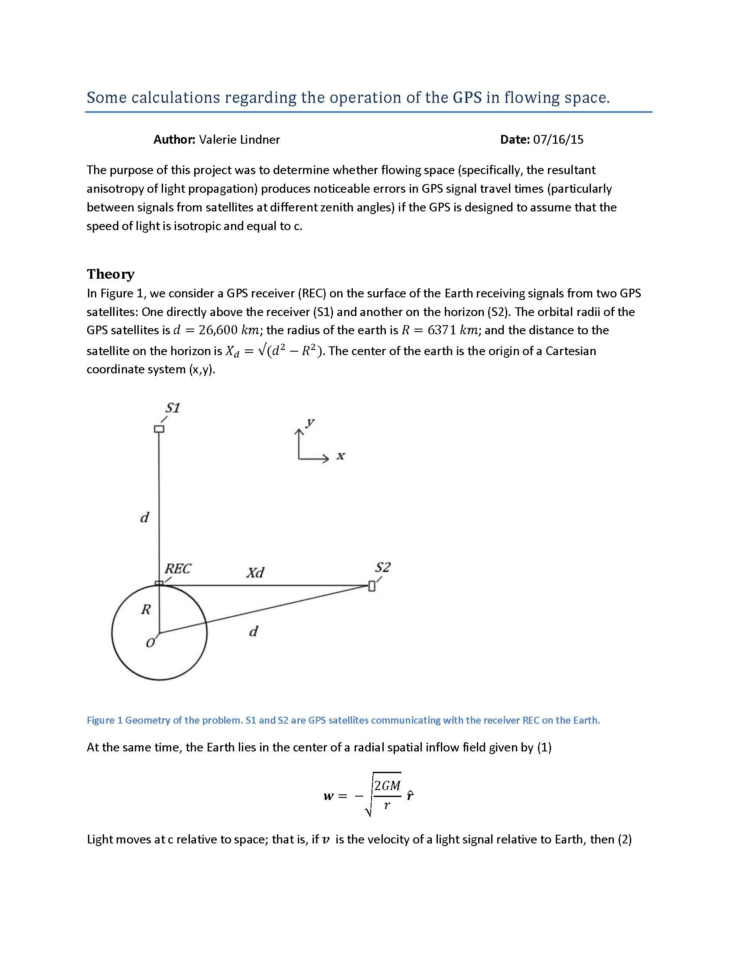
Q: Wouldn’t a radially inflowing Space create an overhead—horizon anisotropy in GPS signal paths?
Also reproduced the Shapiro Time Delay
Yes: ≈2.4mm
(within known margin of error)
Similar result for VLBI
(Very Long Baseline Interferometry)

Slide 46
Flowing Space Reproduces GR’s Successes—More Simply
Painlevé, P. [Classical Mechanics and the Theory of Relativity], C. R. Acad. Sci. 173, 677-680 (1921)
Gullstrand, A. [General solution of the static body problem in Einstein’s gravitation theory]. Astronomi och Fysik, 16(8), 1-15 (1922)
Ives, H.E. Behavior of an Interferometer in a Gravitational field, J. Opt. Soc. Am. 29, 183-187 (1939) 10.1364/JOSA.29.000183
Ives, H.E. The Behavior of an Interferometer in a Gravitational Field. II. J. Opt. Soc. Am. 38, 413-416 (1947) 10.1364/JOSA.38.000413
Kirkwood, R. The Physical Basis of Gravitation. Phys. Rev. 92, 1557-1562 (1953) 10.1103/PhysRev.92.1557
Kirkwood, R. Gravitational field equations. Phys. Rev. 95, 1051-1056 (1954) 10.1103/PhysRev.95.1051
Kirkwood, R. The physics of a metric space with a time variable. Int J Theor Phys 7, 391–414 (1973) 10.1007/BF00713242
Martin, T. On the Motion of Free Material Test Particles in Arbitrary Spatial Flows (1999) gr-qc/9807006
Martin, T. General Relativity and Spatial Flows: I. Absolute Relativistic Dynamics (2000) gr-qc/0006029
Hamilton A.J.S., Lisle, J.P. The River Model of Black Holes, Am. J. Phys. 76, 519 (2008). 10.1119/1.2830526
Tegmark, M. Seeing Black Holes, dir. S.Cooter, BBC/Science Channel (2010)
Lindner H.H. Beyond Newton and Einstein to flowing space, Phys. Essays 25(4), 500-509 (2012) 10.4006/0836-1398-25.4.500
Braeck, S., Grøn, Ø.: A river model of space. Eur. Phys. J. Plus 128, 24 (2013). 10.1140/epjp/i2013-13024-2
GR is an observer-contaminated corruption of Flowing Space
Best

Slide 47

Space Has Parts And Motion
A massless, frictionless fluid—the medium of gravity-inertia and electromagnetism
Discrete-quantized: Composed of contiguous complex “cells” at the Planck scale (?)${ (10}^{−33}cm)$
(Quantized Space is why mathematics works!)
Length: A number of Spatial cells
Time: Cosmic evolution—endless procession of causes and effects.
Clock: Any highly regular physical process is a standard for describing Cosmic evolution

Slide 48
Cellular Space Theory
DUAL Fluid Dynamic and Electromagnetic Nature:
As Spatial cells flow into and around matter they also conduct electromagnetic motions like an extremely rigid elastic solid (at c).
Subatomic particles are various persistent motions and alterations in/of Spatial cells.
Compressible: Equations of flow indicate that Space is not an ideal fluid; cells must deform or disappear in gravitational sink flow
We must ascribe to Space whatever qualities are needed to explain the phenomena.

Slide 49
Answer: Space is the Ground of all Being
All Cosmic phenomena result from alterations and/or motions of/within Space.
Less complex entities combine and interact in new ways, producing more complex entities:
  Astrophysicochemical – Space, light, subatomic particles, atoms, chemicals, gravity (stars, planets, galaxies)
  Biological – molecules, prokaryotes, eukaryotes, multicellular, histologic (RNA-DNA, bacteria, plants, animals)
  Neuropsychological –sensation, neurons, information processing, brains, emotions, consciousness (higher animals)
  Linguo-Mythic – language → toolmaking, culture, religion, civilization, technology (Homo sapiens)
  Linguo-Philosophical – disciplined linguistic information processing (7th cent. BC Ionia—Our Potential)

Slide 50
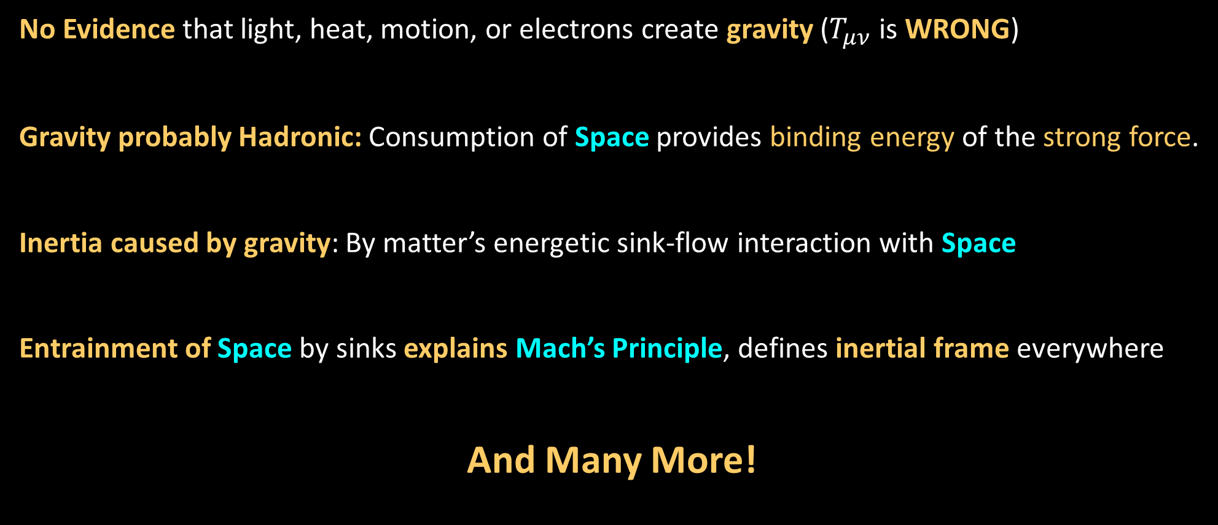
Flowing Space Leads to Many Hypotheses
No Evidence that light, heat, motion, or electrons create gravity ($T_{μν}$ is WRONG)
Gravity probably Hadronic: Consumption of Space provides binding energy of the strong force.
Inertia caused by gravity: By matter’s energetic sink-flow interaction with Space
Entrainment of Space by sinks explains Mach’s Principle, defines inertial frame everywhere
And Many More!

Slide 51
The MESS: Physicists’ Confusion
Indoctrinated at young age with textbook versions of Relativity and QM
TAUGHT LIES: Michelson-Morley experiments and SR disproved physical space
Relativity and QM are physical theories
Want to understand Cosmos but are saddled with subjectivistic models invented to avoid all Cosmic-physical theory!
Forced to reintroduce Cosmos and physical Space—surreptitiously to maintain the LIES.
Result: Nonsense, contradiction, complication, and unreality

Slide 52
Objective Ether-Space Surrogates Everywhere!
Space-time: Their stand-in for physical inertial-EM Space and its effects
Objective/Cosmic Frames: inertial, “absolute”, co-moving, Sun-Star, etc.
Physical Space—without “-Time”: curved, inflating, expanding, etc.
Vacuum—light moves at c in vacuo, zero point energy of the vacuum
Fields: electromagnetic, gravitational, etc. (require a medium!)
Quantum loops, strings, fields, membranes, branes, foam
Higgs Field: to “give” particles “mass”
Condensates: e.g., Quark-antiquark (QQ⁻)
Extra dimensions, “curled up” dimensions
As long as they don’t say “ether” they are OK!

Slide 53
Surrogate Causes: Idealism and Atomism
Idealism: Lacking physical causes, the observers’ ideas and information become causes:
  Space-Time: “Fabric of the Cosmos” and cause of motion!
  Time: Magical thing/dimension that can slow down, stop, and reverse
  Energy: Magical power or fluid that flows from here to there and does stuff
Atomism: All physical phenomena caused by particles interacting within a void:
    Standard Model: 12 magical self-existent particles and 4 magical forces (Ad hoc: 26 free parameters)
    No physical mechanisms—“particle exchange” causes EM attraction and repulsion, inertia, gravity, etc.?
  Hypothetical particles: Never observed and make no physical sense—photon, gluon, graviton, Higgs boson, inflaton, axion, virtual particles, WIMPs, etc.
  Ultimate Irony: Physicists use Machian QM to theorize about unseen Cosmic particles and processes!

Slide 54

Neutron
Photon
Dark Matter Particle
Proton
e-Neutrino
Z-Boson
Graviton
Tau
τ-Neutrino
Strange Quark
Bottom Quark
μ-Neutrino
Top Quark
Anti-Neutrino
Higgs Boson
Charm Quark
Positron
Up Quark
Muon
Down Quark
Gluon
W-Boson
Electron
Atomism is like Creationist Biology
  “Particle Zoo”—scores of self-existent particles interacting within a void
  No possible explanations for their origins or interactions.

Slide 55
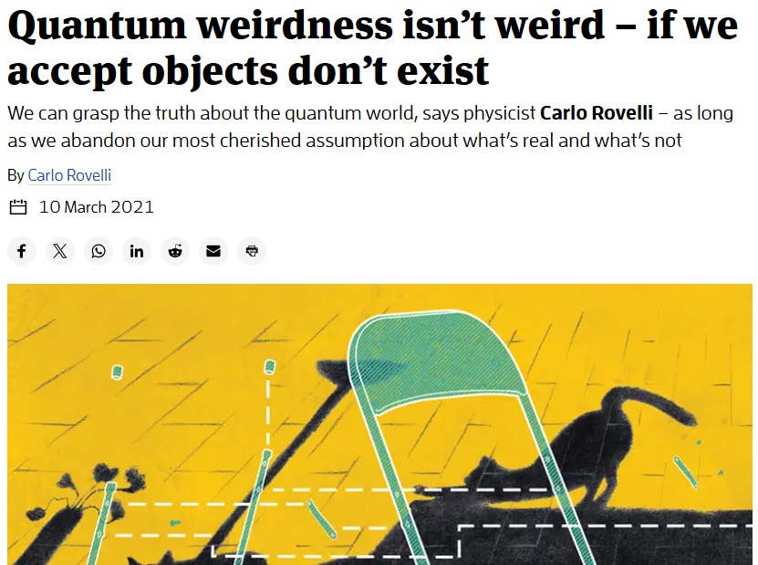
Things don’t Exist, only Interactions do.
(with observers or “systems”)
Rovelli trying to
rationalize
subjectivism

Slide 56
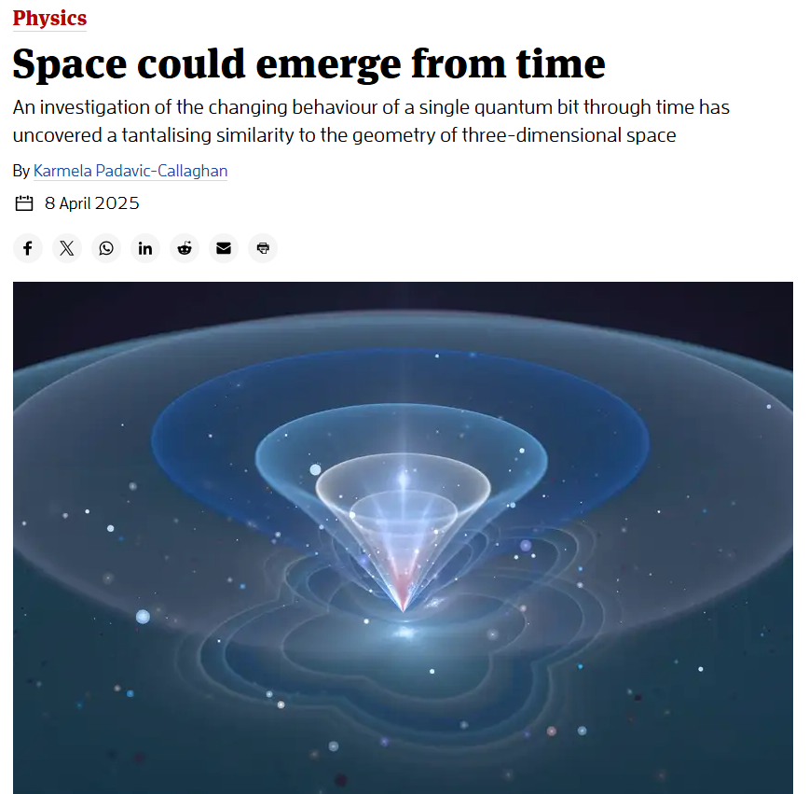
Idealism

Slide 57
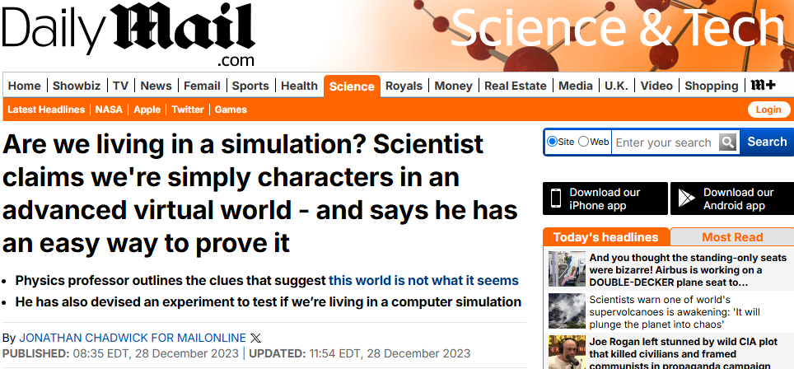
Returning to the Source: Berkeley’s Matrix
If you feel like you're living in a computer simulation like The Matrix, you might actually be onto something, according to an associate professor in physics

Slide 58
Without Physical Space Everything is Magic
Physical Phenomenon | Modern Physics | Space Theory
Space | Non-physical void | Inertial-EM medium
Light’s fixed velocity independent of source velocity | Magic Observer-Law | Wave in EM Space
Atomic redshift with velocity (slowing atomic clocks) | Magic time dilation | Atom’s Velocity in EM Space
Limiting velocity for matter | Magic Observer-Law | EM matter in EM Space
Gravity | Magic Observer-Law | Flow of inertial-EM Space
Inertia (acceleration/rotation) | Magic “Absolute” effects | Motions wrt Inertial Space
Quantized light-matter interactions | Magic Photons | Electrons’ EM structure
Four Forces | Magic particle exchange | Motions in/of Space
Black hole singularity | Magic Math | Condensed matter
Dark Matter | Magic Invisible Particles | Interactions of Spatial flows
Dark Energy | Magic Unknown Energy | Production of Space?
Life, Consciousness | Magic from Magic | Hierarchical Evolution

Slide 59
SOLUTION: Philosophy and its Sciences
Yet this very philosophy it is that ought to be esteemed the great mother of the sciences. For all arts and sciences, if torn from this root, though they may be polished and shaped and made fit for use, yet they will hardly grow...
Let no man look for much progress in the sciences…unless natural philosophy be carried on and applied to particular sciences, and particular sciences be carried back again to natural philosophy. Francis Bacon Novum Organum, Aphorisms, 1xxix and 1xxx (1620)
We must: Always ask “WHY”: Seek the cause:
Recreate physics and philosophy with current knowledge:
Replace observer physics with Space physics
Replace Berkeleyan/Machian Science with Philosophy

